Slide 1
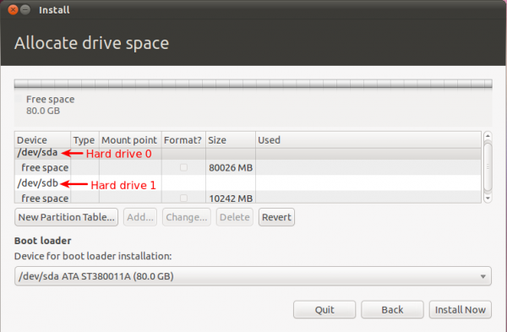
Disk Arrangement ( Allocating )
Allocate filesystems and swap space to separate partitions or disks
Boot files. Some files must be accessible to the BIOS, UEFI, or boot loader at boot time.
Multiple hard drives. Typically each hard drive will be divided into one or more partitions, each with a filesystem that must be mounted somewhere in the filesystem tree.
Potential overflow. If a filesystem might fill to 100 percent of its capacity, it is usually a good idea to separate this from files that are needed to run the system.
Quotas. Quotas limit the amount of space that users or groups can take on a filesystem.

Slide 2
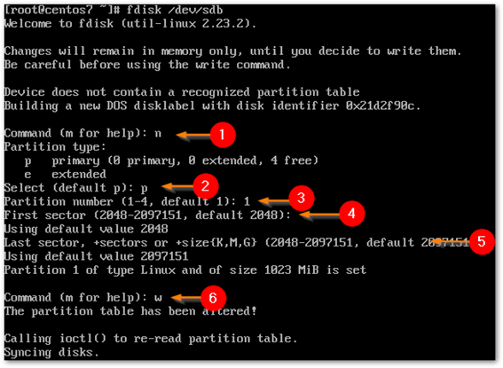
Disk Arrangement ( Partition)
Only two partition root and swap on hard drive.
Directories created under root.

Slide 3
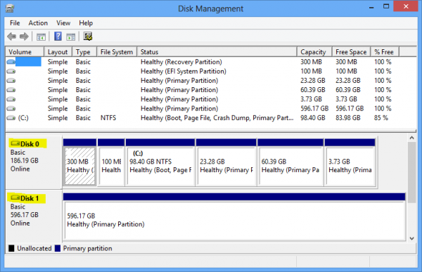
Disk Management ( Dynamic)
Improve performance with a striped volume across multiple disks.

Slide 4
Disk Management ( Basic )
Linux disk management includes several important tasks such as adding or removing storage devices, creating and deleting partitions, mounting partitions on appropriate directories and making file system in partitions.
Improve performance with a striped volume across single disks.

Slide 5
Mounting a filesystem
Device name: Linux disks are named sda , sdb and so on, with the partition's number added to the disk's device, so /dev/sda2 is the second partition on the first disk.
Mount point: Where the filesystem is to be mounted – it must exist.
Filesystem type: It is possible to use auto here and let the kernel figure it out for you, but with a fixed disk it makes sense to be specific.
Mount options: The keyword defaults means use whatever is standard for that filesystem. Specific settings can be given here, separated by commas.
Dump: Used for a particular type of backup, normally left at zero.
This is used by fsck to set the order in which filesystems are checked when booting. Set to 1 for the root partition and either 2 or 0 for others – 0 means do not check.

